Slide 1
Dagger 2
Dependency Injections In Android

Slide 2
What is Dependency Injections
Dependency injection is a technique whereby one object supplies the dependencies of another object. A dependency is an object that can be used (a service). An injection is the passing of a dependency to a dependent object (a client) that would use it.
Wikipedia

Slide 3
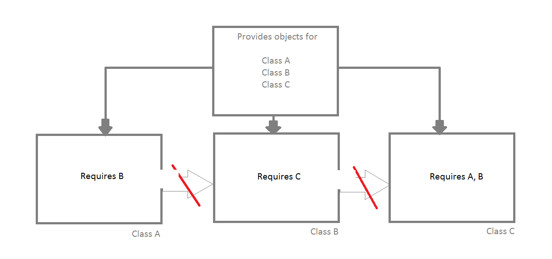
D.I Flow

Slide 4
What is Dagger 2
In simple words, Its an Dependency Injection Framework maintained by Google.
Its is based on Java Specification Request 330.
Dagger 2 uses generated code rather than reflection (like in Dagger 1).
Have three building blocks named as Modules, Provides and Components.

Slide 5
Building Blocks Of Dagger 2
@Modules : Classes with this annotation provides the dependencies required by other classes.
@Provides : Methods with this annotation is responsible to create the object for injection.
@Components : Its a bridge between the modules and the object which requires the dependencies.

Slide 6
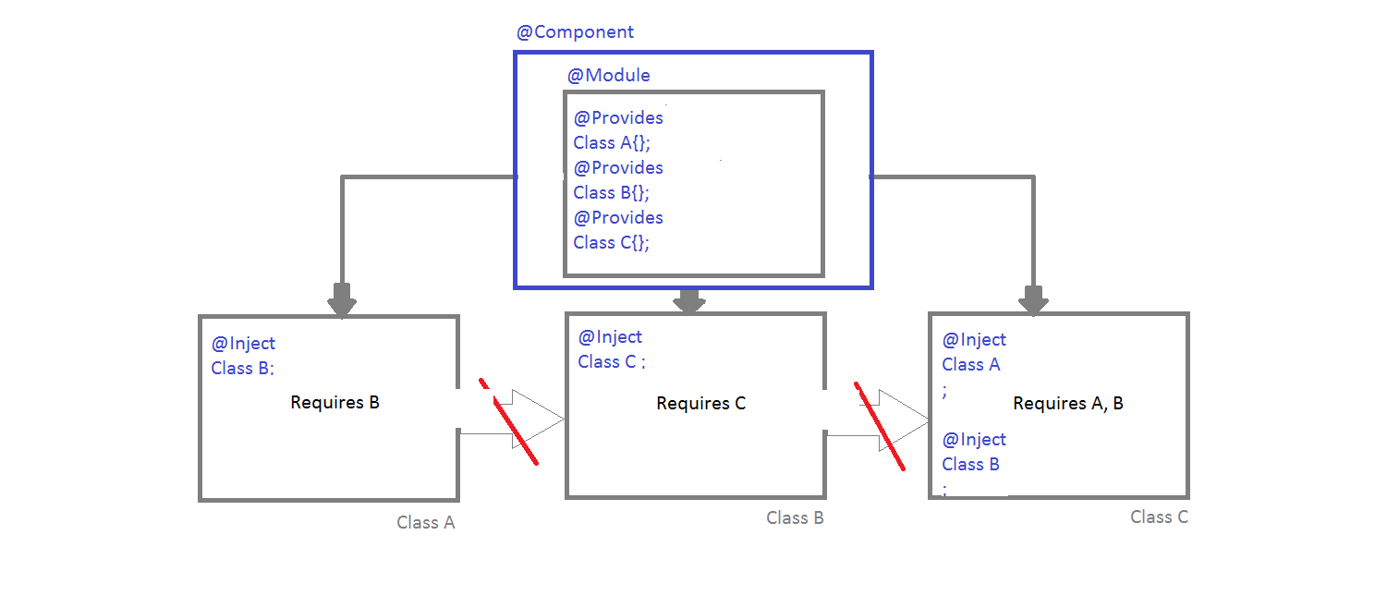
Dagger 2 Flow

